Slide 1
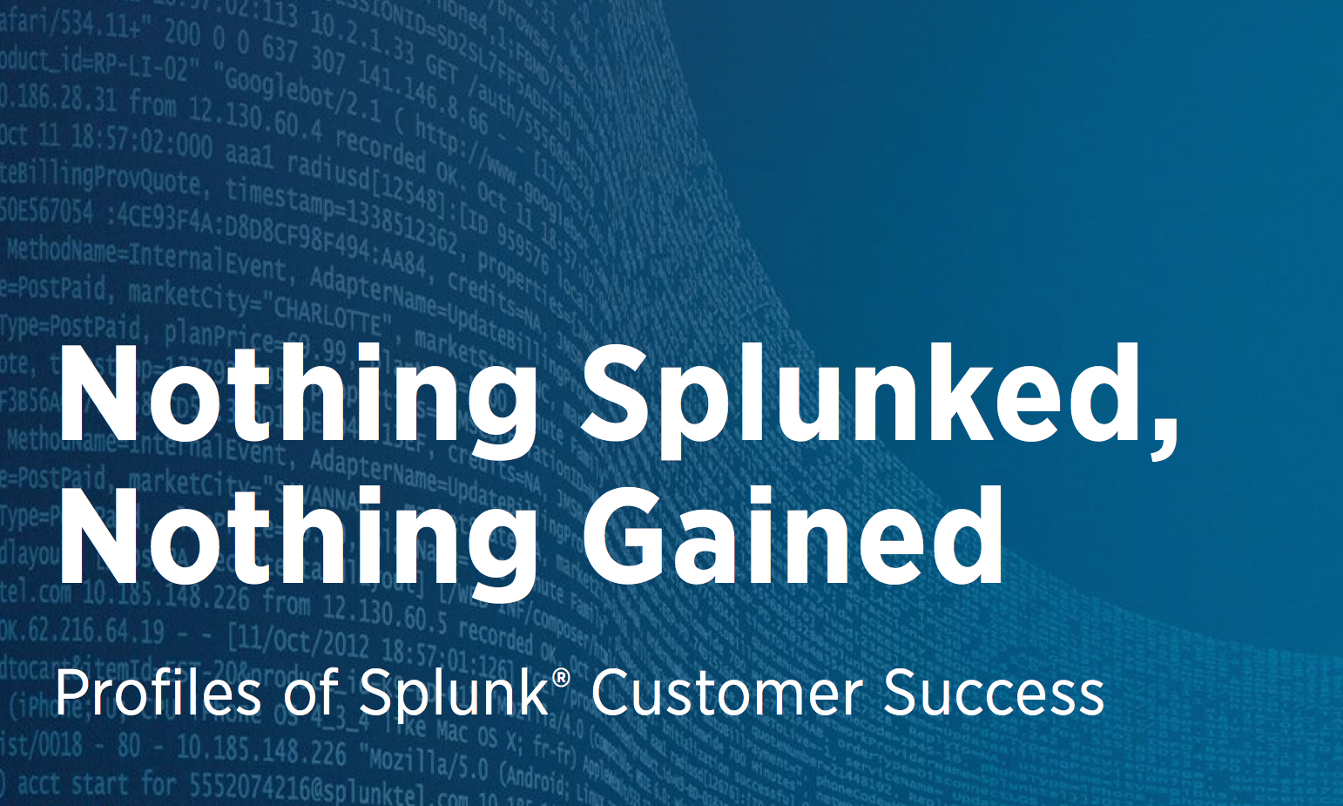
Splunk Customer Stories . . . Q3 ScoreCards, Progress, Statistics, Feedback & Content Strategies Carolyn McDonough

Slide 2
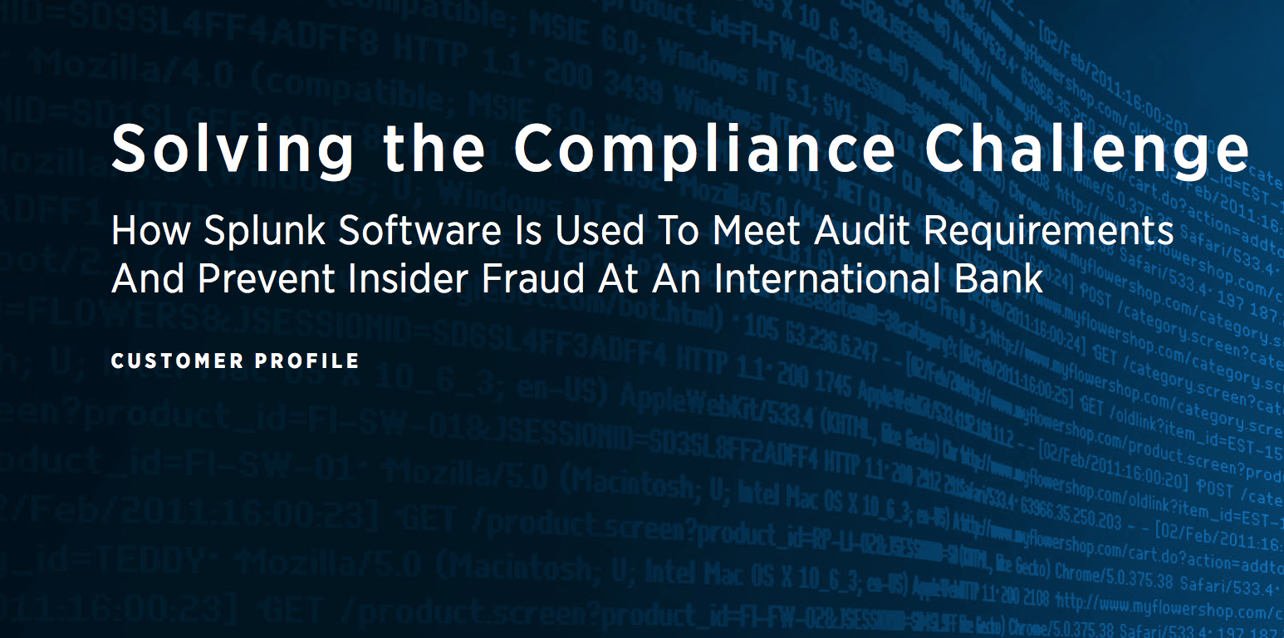
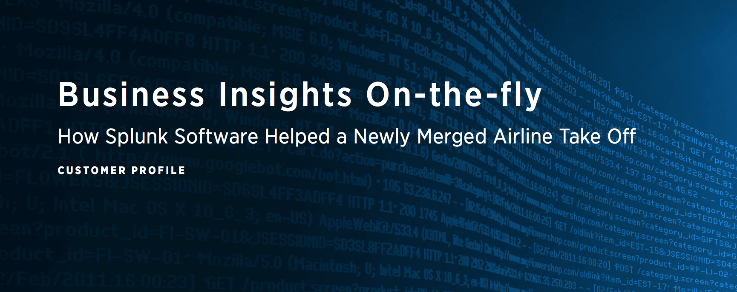
Two new chapters published

Slide 3

A few reviewer comments. . .
“ These are impressive and I look forward to more like these. . . to help customer(s) expand their minds regarding what Splunk can actually do.” Maverick Garner
On Banking & Airline stories
“Overall the paper is really interesting. Good job capturing the concepts.”
Robert Ma on Compliance/Banking Story
“Overall, great job. I love the story. It points out some really cool stuff we did for this customer. I had to read it twice just to see if I could add any value. :).” Cindy McCririe on Gaming Story (in final draft stage)

Slide 4
Some Buzz from Sales . .
“This is fantastic! Thank you.” Stella Gonzalez on the Airline Story
I am reading this document and like it a lot. In timing with the holidays and possibly correlations, I will forward this now.
Thanks,
Eric Beller
Regional Sales Manager
On the Banking Story
“Personally, I really appreciate these resources, so, thank you!”
Jason Stein
Using the airline story as a way to gather interest from a stalled airline client
Notes:
From DAVID (Carolyn edited slightly)

Slide 5
A sample of SKO/TKO connections
“It was a pleasure [discussing the Chip manufacturing story] with you. . . It’s great that we have an awesome tech writer who can make these stories come alive!”
” . . .the potential market for this use-case can be huge!!”
Young Cho
Splunk Inc., Solutions Architect”
Hi Carolyn,
It was nice meeting you the other night. I just wanted to quickly follow up and see if you could shoot over the link for the airline story, thanks!
“We'll use it at American [Airlines]”.
Scott McCurry
Major Accounts Manager ” Maverick on Barclay & LATAM story
Notes:
From DAVID (Carolyn edited slightly)

Slide 6
On deck . . .
HIGH VALUE , HIGH DEMAND STORY! Chip Industry: Have met with SE’s and attended presentation at TKO. This one story could literally accelerate the sale of millions of dollars of Splunk to the manufacturing industry.
Gaming: Has had 3 reviews, including one with a new reviewer that reversed the direction, requiring extensive rewriting.
State Govt Agency: This has also been through 3 reviews, as well as an interview with the team. The entire thrust of the story has to be changed away from fraud, as I had written it, to web analytics, due to a political scandal in that relevant state.

Slide 7
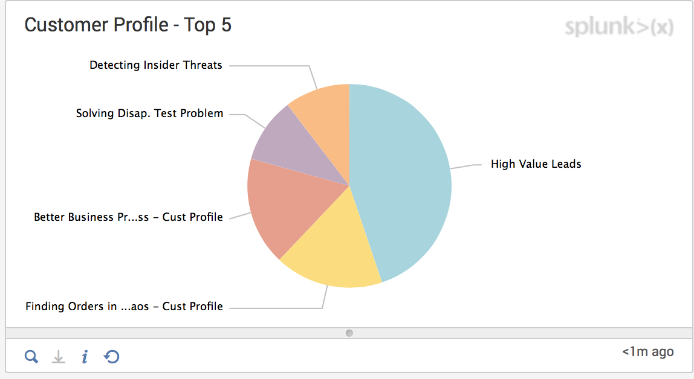
Who is Reading the Book and Stories?
Using SFDC and Splunk (x) we can see who is downloading the stories. This is a Splunk(X) representation.

Slide 8
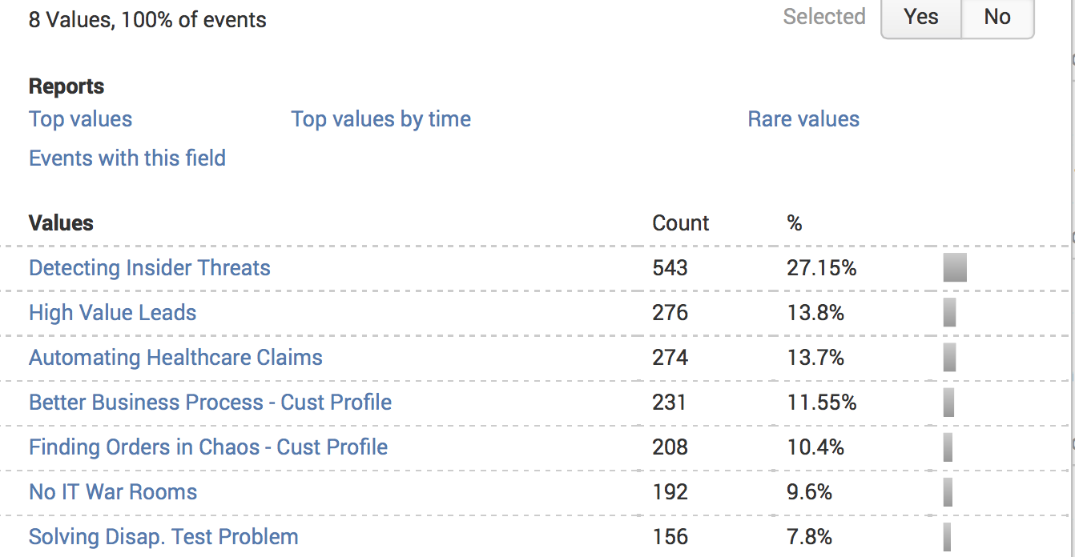
Public access to stories in the book since Nov 1, 2014
Notes:
This slide illustrates more of a timeline or progression for completing major savings during the course of an investor’s lifetime. The slide serves to answer the age-old question, “Where am I now and where do I start?”.

Slide 9
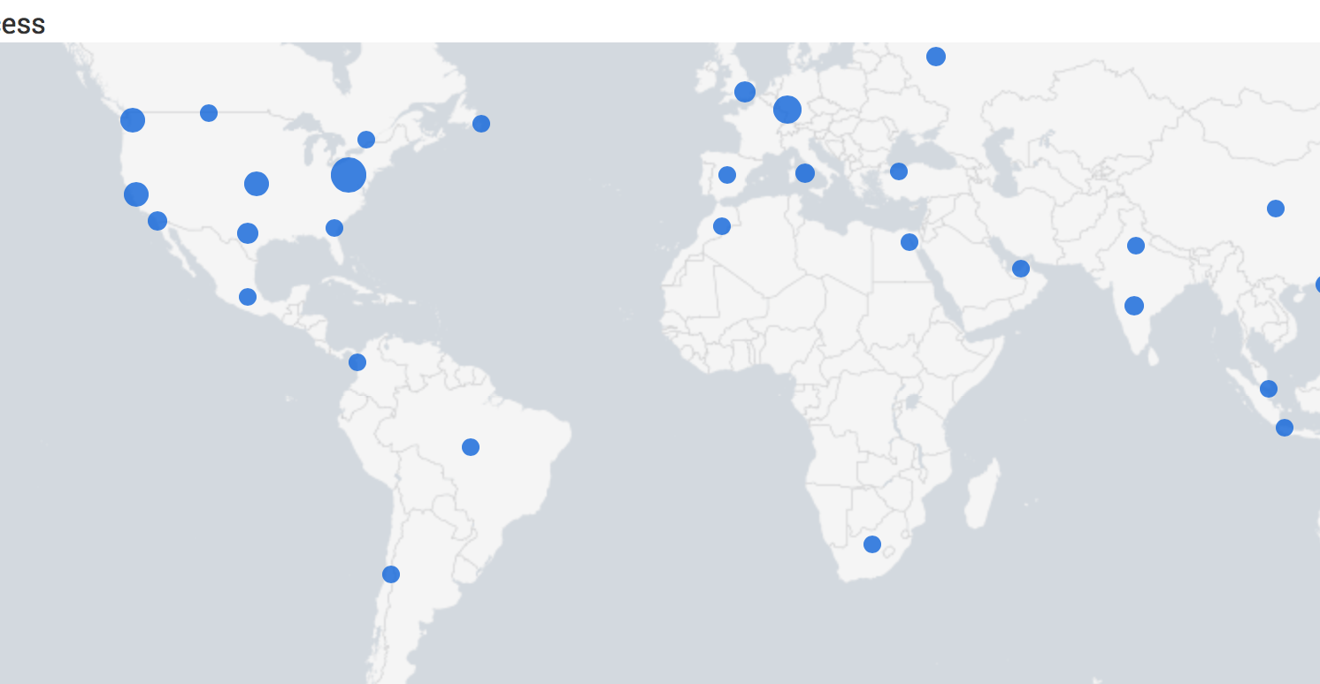
International Impact! Splunk Map showing access to Customer Profiles
Notes:
This slide illustrates more of a timeline or progression for completing major savings during the course of an investor’s lifetime. The slide serves to answer the age-old question, “Where am I now and where do I start?”.

Slide 10
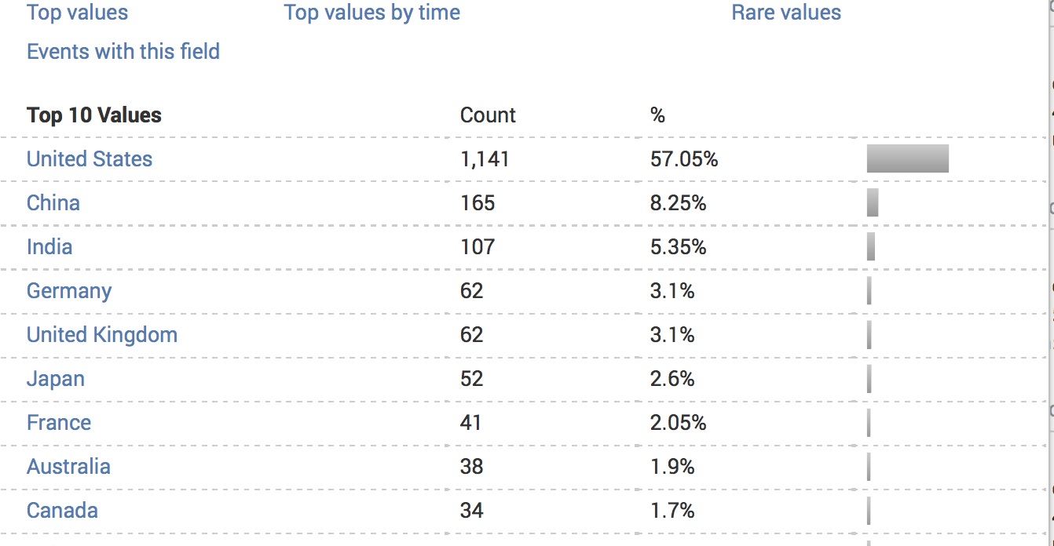
International Impact! Drill Down

Slide 11
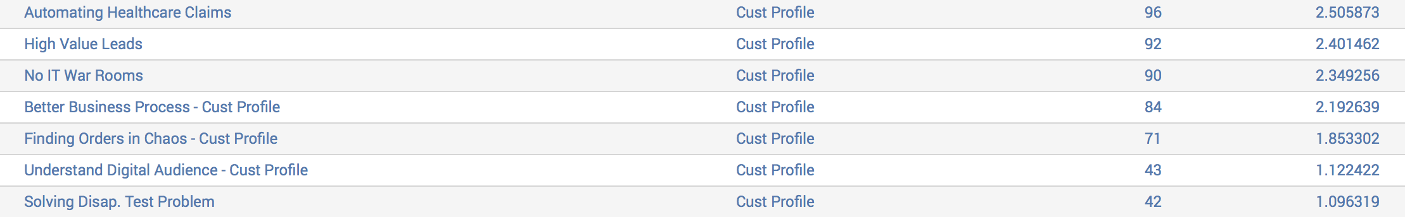
Downloads of Customer Profiles
Candidate Story…

Slide 12
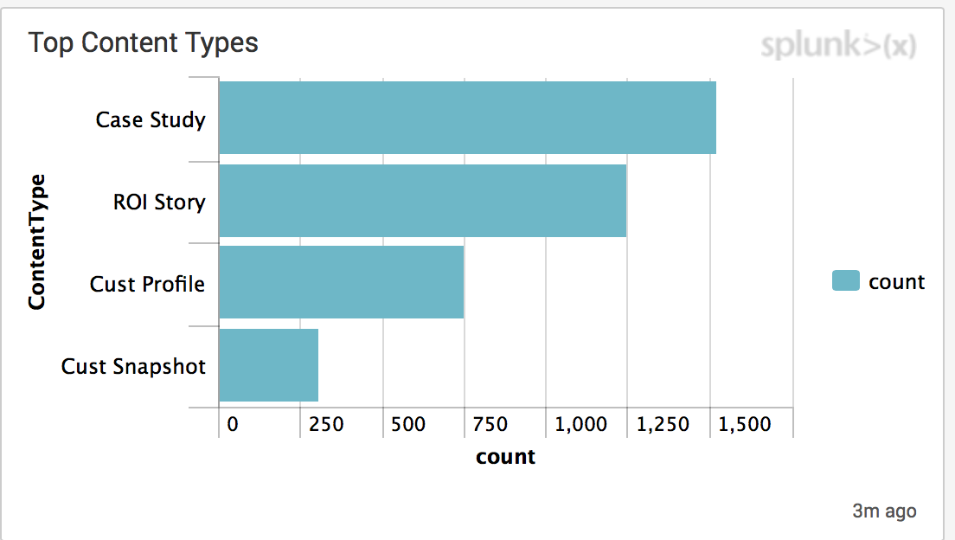
750 downloads in 6 months
Candidate Story…

Slide 13
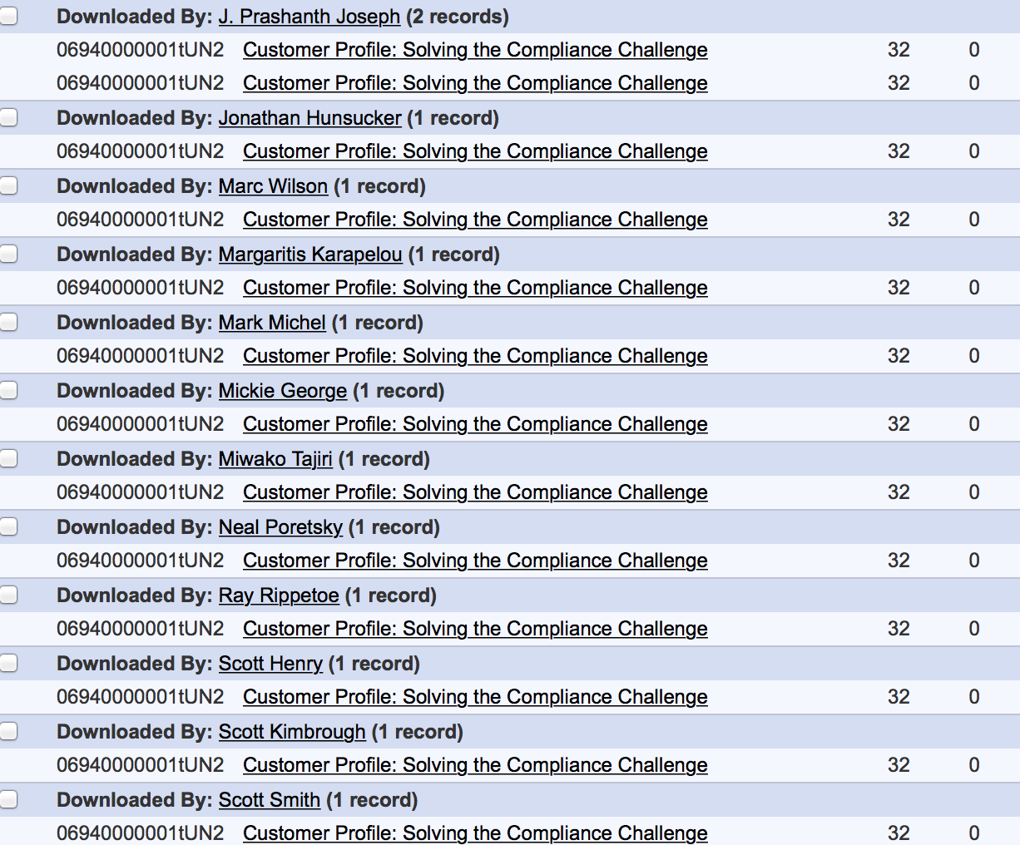
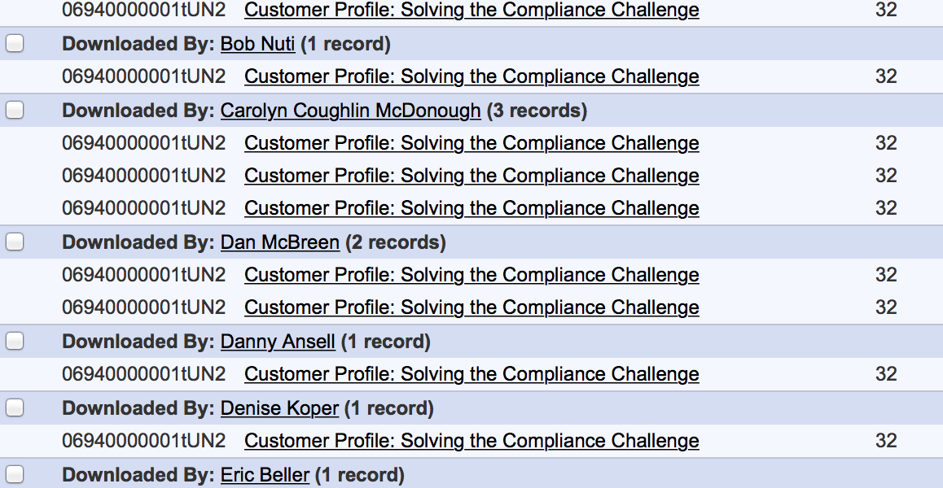
Here are metrics from SFDC, showing Splunkers who have downloaded the Banking story . .
Adrian Perry, Andrew Hershey, Bob Nuti, Dan McBreen,
Danny Ansell,
Denise Koper, Eric Beller,
Erik Rodriguez, J. Prashanth Joseph, Jonathan Hunsucker, Marc Wilson, Marck Michel, Mikie George, Miwako Tajiri, Neal Poretsky, Ray Rippetoe, Scott Henry, Scott Kimbrough, Scott Smith, Sheri Carrol, Takashi Komatsubara, Tammy Perkins, Thomas MacIsaac, Tobais Ahlin

Slide 14
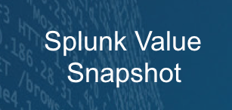
How can we Splunk Value from Stories that didn’t make it? Value Snapshots!
Sometimes, for various reasons, a story doesn’t have enough details or is too sensitive to publish, or sales asks that we hold it for a while. Here are some slides created to capture and share this information in useable ways. I have shared them with Ben Harris, who thinks he may be able to use them in enablement.

Slide 15

*EMEA Insurance Company Racing the Rate Raiders . . . Strategic Value
What if your own resellers get the customer before you do?
Potential customers were coming directly to the insurance company’s site. But it was down—50% of the time!
Customers already interested in this Insurance Company would leave this site, go to an aggregator and buy the insurance from there, forcing the company to pay commission on a customer they had already sold!
Splunk Insights:
Uptime improved by 100%
Site Performance enhanced Conversion Rate
Enter Splunk !
Monetary Value: Higher Margin per policy sold
Strategic Value: Direct customers are more loyal, and margins are far higher
Web Analytics

Slide 16
*EMEA Bank $Strategic “Splunk saved our assets!”
“How did we forget that?”
Business asked the bank’s development team to create a mobile banking app in 7 months—an app that IT estimated “should” take 2 years.
In the rush to create the app they discarded their normal processes:
Two weeks before launch date, the team realized that a critical component was missing: security monitoring
External regulators—and internal risk management--threatened to halt the highly advertised launch
Splunk Platform to the rescue:
Leveraging their existing Splunk deployment, bank security experts added quality security & compliance monitoring to the app in 2 weeks –in time to make the original launch date!
Business Analytics
Enter Splunk !
Security
Significant Strategic Value:
The bank met the highly-publicized launch date, allowing them to capture the earliest mobile adopters in their region and preserve their reputation.
Unprecedented partnership formed between Business & IT.
Since Splunk software is integral to the app, it brings multiple dividends in security, monitoring, and analytics.

Slide 17
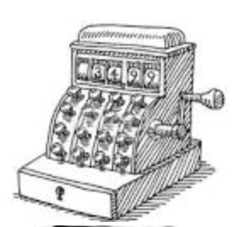
Retail . . $2M “Splunk stopped weeks of lost orders--in 7 days”
2 months of lost orders
Browser was dropping buyers
No idea why
$2M lost as buyers left for competitors
In One Week:
Splunk discovered the problem, which was a browser SSL issue.
It took alteration to 1 line of code, and the $2M problem was fixed.
It would have taken months to find that one line of code without Splunk.
Application Delivery/ Development
Enter Splunk !
Web Analytics
Splunk Value: $ 2M
“With this one incident, Splunk paid for itself.”

Slide 18
*An American Gaming Company Silencing the Trolls. . . $1.5M/yr
How do you read every post in a gamer forum?
If you’ve been on a forum, you’ve seen the problem: the bullies, the spammers, the saboteurs can ruin the customer experience for all.
The company was adding 1 headcount per month to handle the trolls, and 3600 hours/year to respond to law enforcement requests to track other scofflaws down.
With Splunk Software
Splunk ingested forum text. Complex but ingenious searches found rules violations, such as repeat posts, aggressive keyword terms, etc. Now warnings could be sent to offending users, or they could be kicked off.
Splunk dashboards reduced the time spent answering law enforcement requests by 90%.
Enter Splunk !
Monetary Value: $1.75M
New hiring reductions: $1.5 M /year
Time for Law Enforcement requests: Reduced from 3600 to 360 hours: $250 K/year
Strategic Value
Satisfied Forum Customers, sharply reduced complaints
Security

Slide 19
“Data Was a Big Spaghetti Mess” @ Benefits portal company . . $Strategic Value
The Challenge
Customers who used this benefits services portal logged on and stayed on as they clicked and waited at each turn. . This cost money. The company wanted them to get on and off quickly.
The company couldn’t fix or even diagnose the delays because all the components were disconnected.
Splunk Software Broke down barriers:
Dropped page loading time by 50%
Dropped time needed to alter benefits choices, increasing customer satisfaction.
Enter Splunk !
Strategic Value
Retained customers
Improving retention
Easier attraction of new clients
Reactive to Proactive .
Web Analytics

Slide 20
From random fraud-finding to targeted answers a bank saved $5M/yr
The Challenge
Employees at a major bank were overwhelmed: They could see fraud but only follow up on 5%
The SIEMS kept choking because they couldn’t take in all that data, either
Splunk Software
Splunk took all the data in, replacing the traditional SIEMS.
Splunk gave employees the tools to ignore false positives, find the true issues, and prevent dangerous oversights before they found them the hard way.
Enter Splunk !
Monetary Value
$2.5 M /year redirected
$2.5 M/year avoided cost
STRATEGIC VALUE
15 security staffers to higher value work
Instead of a sample, they saw the entire landscape.
Security

Slide 21
Is there a way to help Sales study or share these stories? !
What if we presented stories as Value Cards?
This idea came from a similar project in School of Splunk. I adapted it to the story content. Some examples are shown here.

Slide 22


Stories as Value Cards
Splunk Helps a Bank Capture Early Mobile Adapters
Security & Apps Delivery
Challenge: Insane Deadline
Built With Splunk . . .
IT estimated that it would take 2 years to create a mobile banking app. Despite this, the business asked them to create the app in 7 month—and advertised this launch date. Why? They didn’t want to lose the newly emerging mobile market.
In the rush to create the app IT realized that they had forgotten a critical component: security monitoring.
Compliance regulators noticed the lapse and threatened to halt the app distribution. Even though the app had been heavily promoted and customers were waiting for it.
Leveraging an existing Splunk Enterprise deployment, bank security experts incorporated security and compliance monitoring into the app.
It took 2 weeks to add the security component.
They met the target launch date!
They captured the earliest mobile adopters.
Strategic Value: Splunk Saved Their Assets !
Web Analytics
Splunk Stops Weeks of Lost Orders—in 7 days!
Challenge: Dropped Web Customers
Browsers were dropping
In one week:
Splunk discovered the problem, one line of code out of thousands
The line was fixed, stopping the $2M loss.
Sleuthed By Splunk . . .
Browsers were dropping buyers
No one knew why
$2 M lost in 8 weeks as buyers left for competitors
None of their existing tools could find the problem
ROI: Splunk paid for Splunk in one week.

Slide 23
IT Operations
Racing the Rate Raiders . . . Insurance Industry
Challenge: “Partner” Pilfering
Solved by Splunk . . .
What if your resellers get to the customer before you do?
Potential customers were coming directly to the insurance company’s website. But it was down –50% of the time!
So customers already interested in this particular insurance would leave the site, go to an aggregator, and buy the insurance from them.
This forced the company to pay commission on a customer they could have sold to directly!
Uptime improved by 100%
Site Performance enhanced conversion rate.
Higher margin per policy sold
Direct customers are more loyal and more likely to buy additional coverage.
Monetary Value: Higher Margin per policy sold
Strategic Value: Direct customers are more loyal, and margins are far higher
Web Analytics
Barring the Trolls . . $3B Video Gaming
Challenge: Trolls on Forum Posts
Stopped By Splunk . . .
Ingenious Splunk searches of forum text found rules violations, repeat posts, aggressive keyword terms. Warnings sent to offending users; repeat offenders kicked off.
Saboteurs, Trolls, Spammers, and Bullies were taking over and dominating the forum, a key aspect of brand identity and customer loyalty for this 25-year old gaming company.
It required one new headcount per month to keep up with the deluge.
New Hire Reductions: $1.5 M first year
Preserved online community: invaluable.
.

Slide 24
Security
SIEMS at Major Bank Choking; Too Much Data
Challenge: SIEM Overload
Secured By Splunk . . .
Existing SIEM could only ingest a subset
IT only followed up on 5% of all fraud
Too many false positives.
Splunk Enterprise ingested everything
Previous SIEMs replaced
No more false positives
15 security staffers reallocated
$5M/year redirected/avoided cost
Splunk revealed the entire landscape
Apps Delivery
& Web Analytics
Cloud File Sharing Company Had No Bandwidth to Plan
Challenge: Rushing to IPO
Splunk Increasing Their IPO Viability. . .
Growing so fast they couldn’t see ahead 3 months
Zero visibility into user experience
No Security Monitoring in Product
Reactive Customer Support
Insights from Splunk dashboards allow them to maximize investment in the areas that drive demand
Splunk-based monitoring platform quickly resolves security and other user issues
Errors reduced by 68%
Reputation Protection in pre-IPO? Priceless.
$250,000 due to calls reduced by half .

